Slide 1

BANKING FINANCE PROJECT

Slide 2
OVER-VIEW
1.Installations
2.Configurations
3.Integrating github
4.Creating Jenkins file.
5. git checkout
6. Build the application
7. Build image
8. Docker login
9. Docker Push
10.Terraform Apply.
11.Selenium Test Cases
12.Monitoring the deployed server

Slide 3
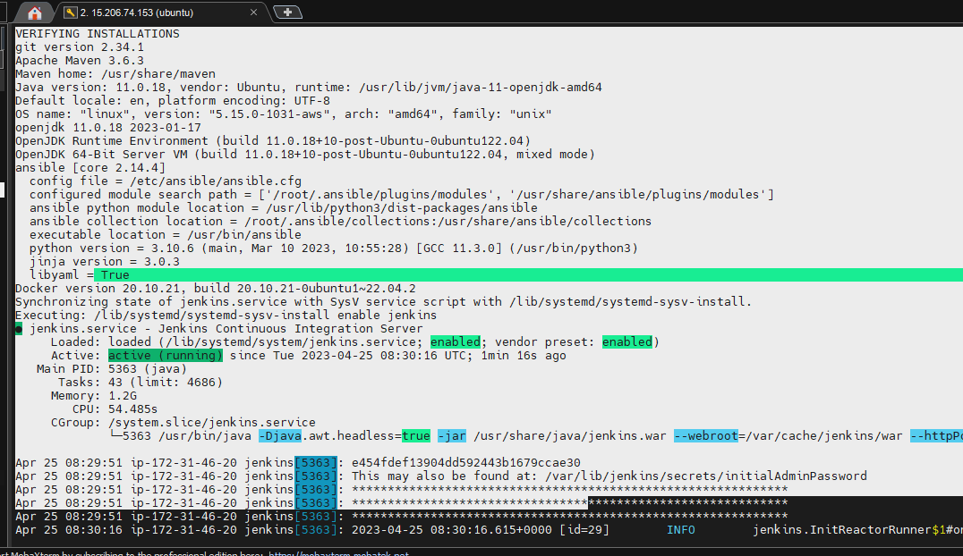
1.INSTALLATIONS

Slide 4
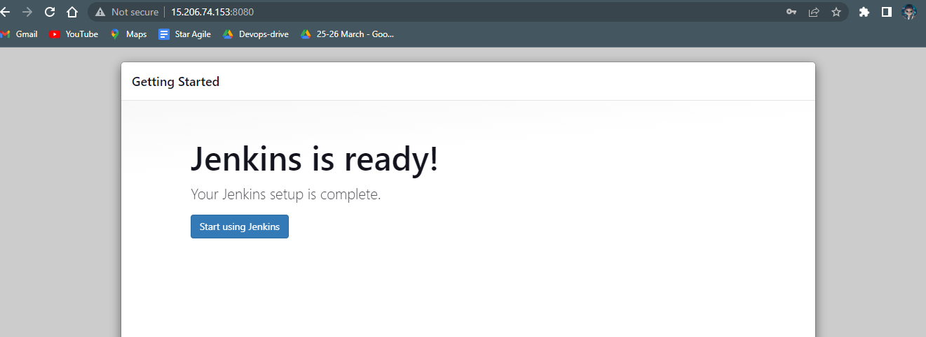
LAUNCHING JENKINS

Slide 5

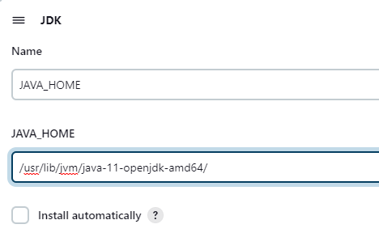
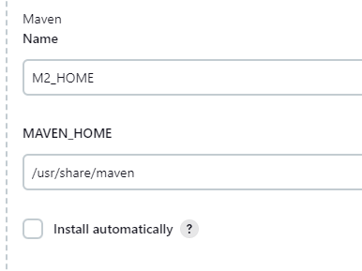
2.CONFIGURATIONS

Slide 6
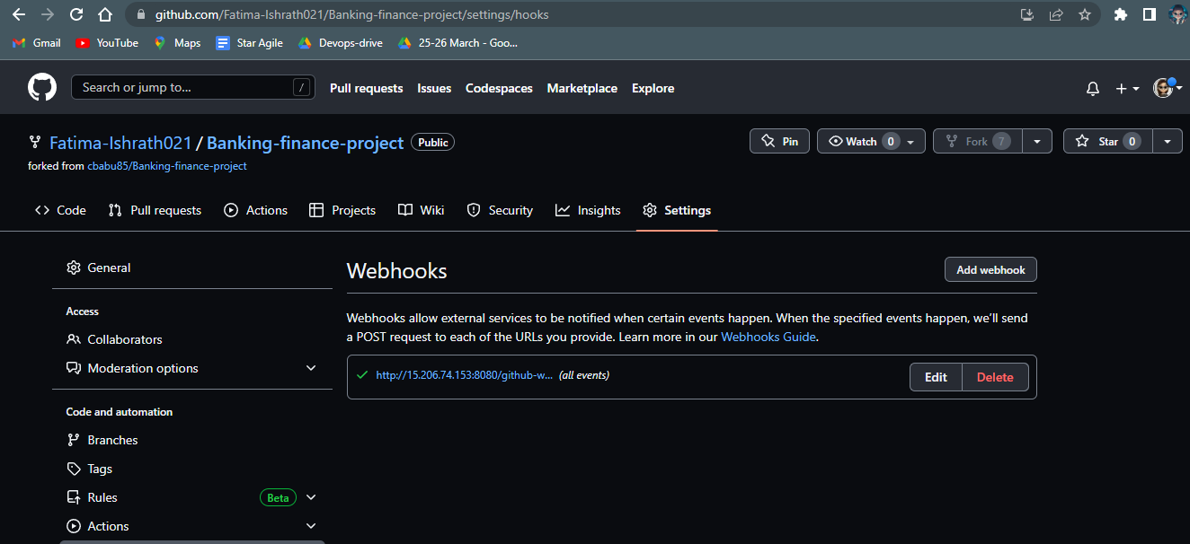
3.INTEGRATING GITHUB

Slide 7
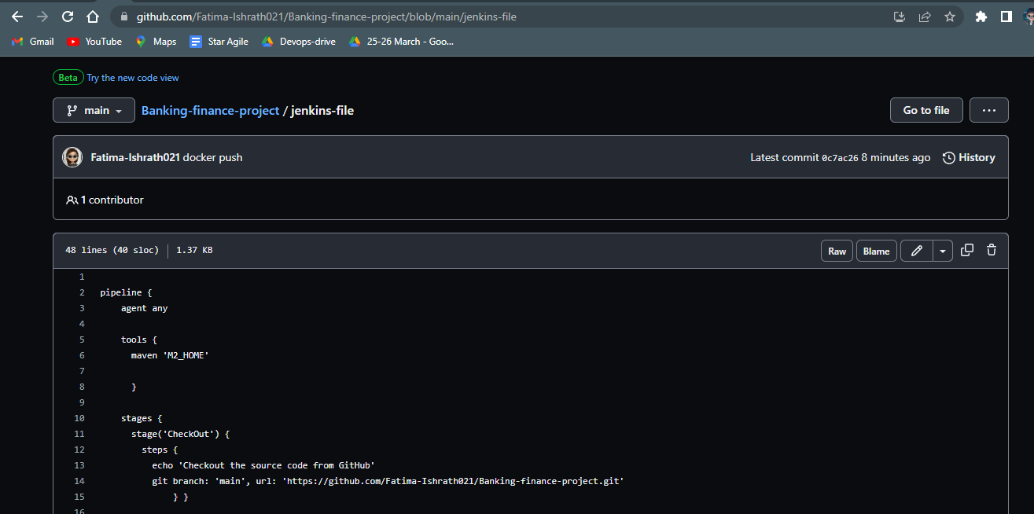
4.CREATING JENKINS FILE.

Slide 8
5. GIT CHECKOUT

Slide 9
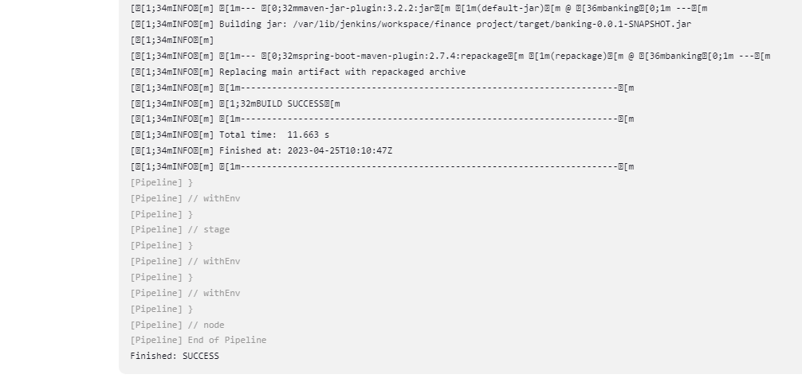
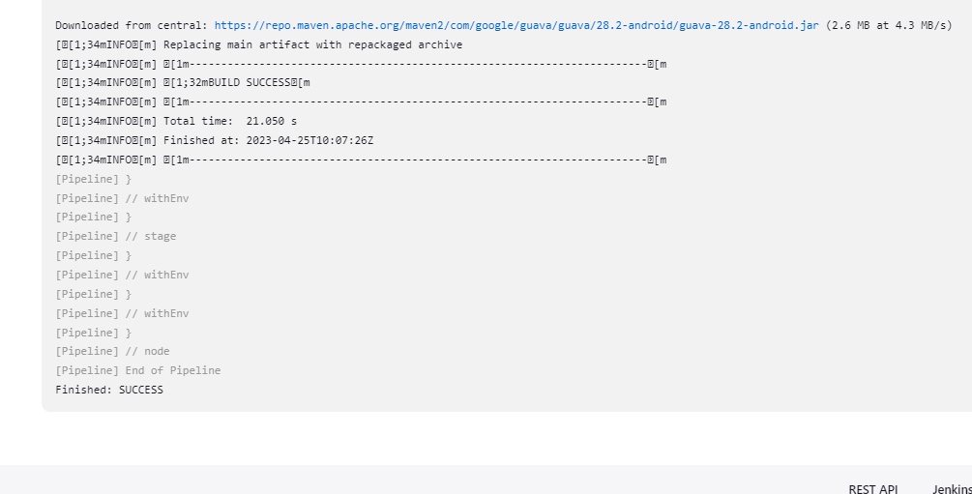
6. BUILD THE APPLICATION

Slide 10
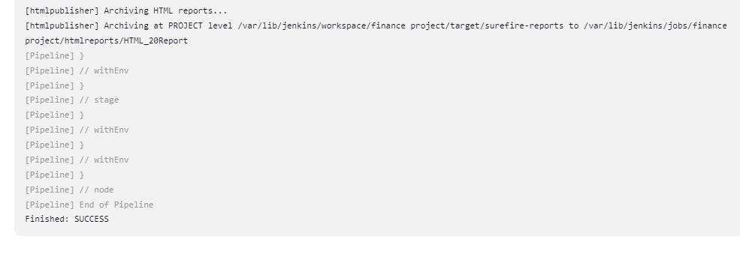
7. PUBLISH HTML REPORTS

Slide 11
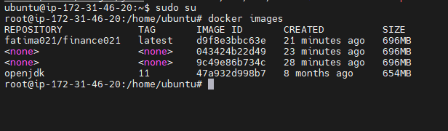
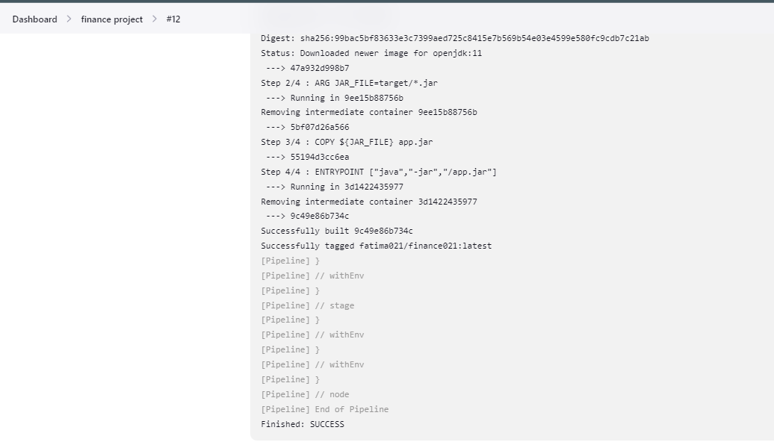
7. BUILD IMAGE

Slide 12
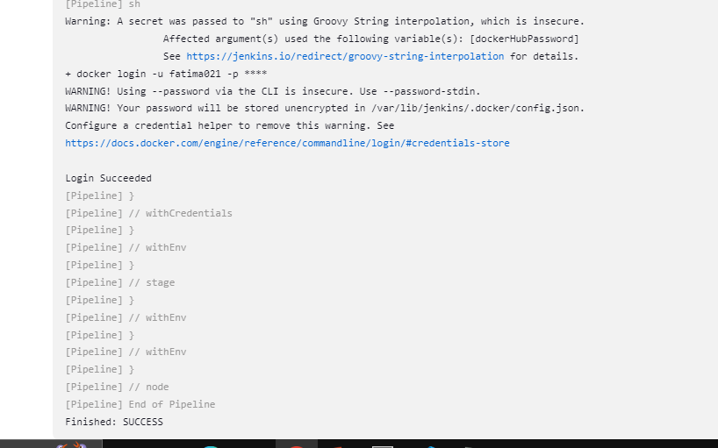
8. DOCKER LOGIN

Slide 13
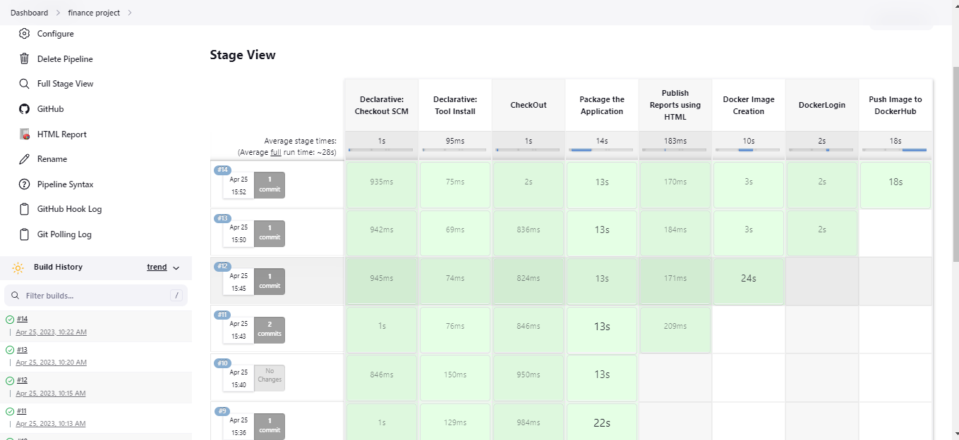
9. DOCKER PUSH

Slide 14
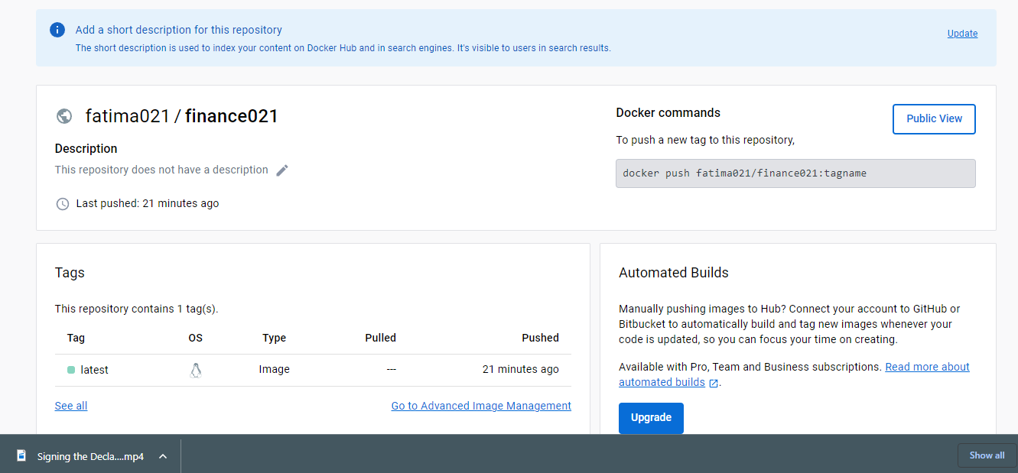
VERIFYING DOCKER PUSH

Slide 15
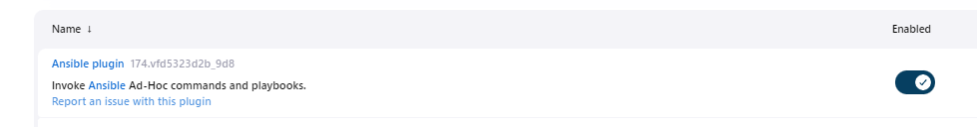
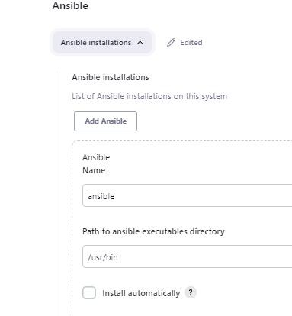
ADD ANSIBLE PLUGIN AND CONFIGURE IT INTO JENKINS

Slide 16
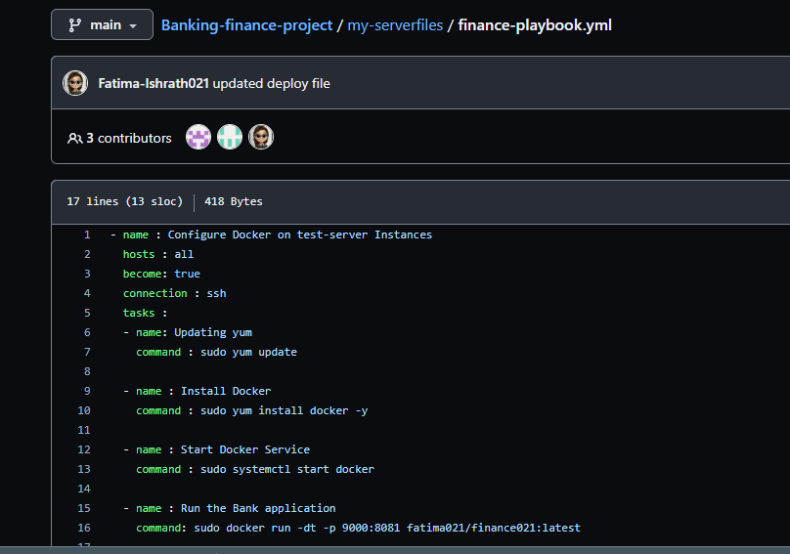
10.CREATE ANSIBLE PLAYBOOK

Slide 17
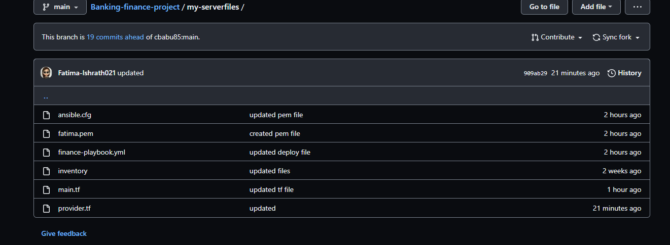
CREATED MY-SERVER-FILES

Slide 18
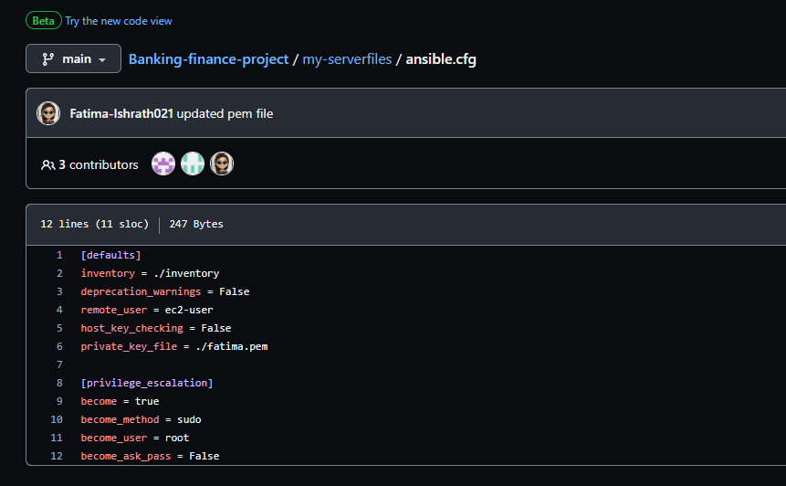
ADDING ANSIBLE.CFG FILE

Slide 19
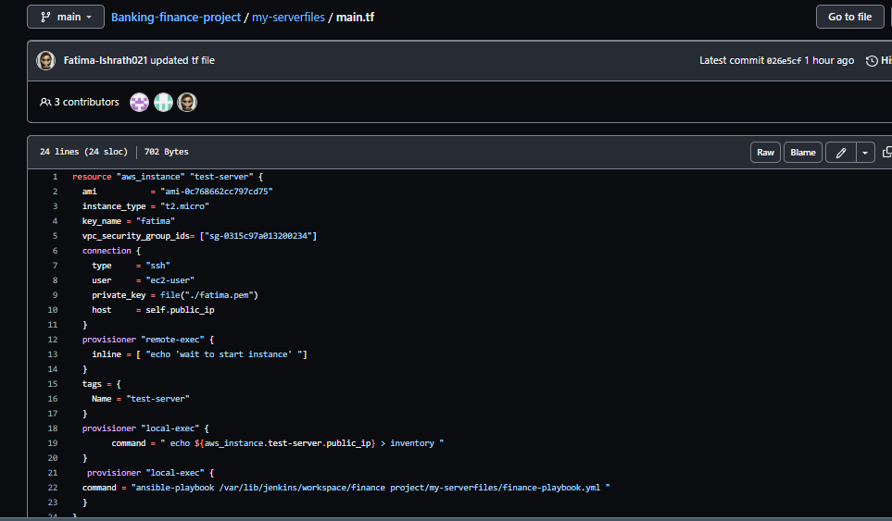
10.CREATE TERRAFOFORM FILE “MAIN.TF “

Slide 20
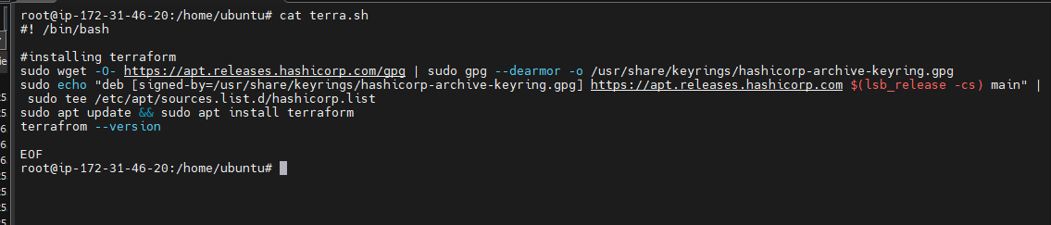
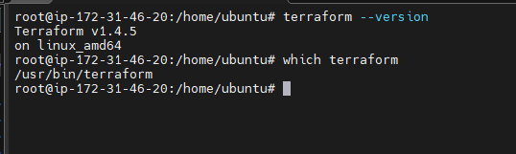
INSTALLING TERRAFORM TO HOST MACHINE

Slide 21
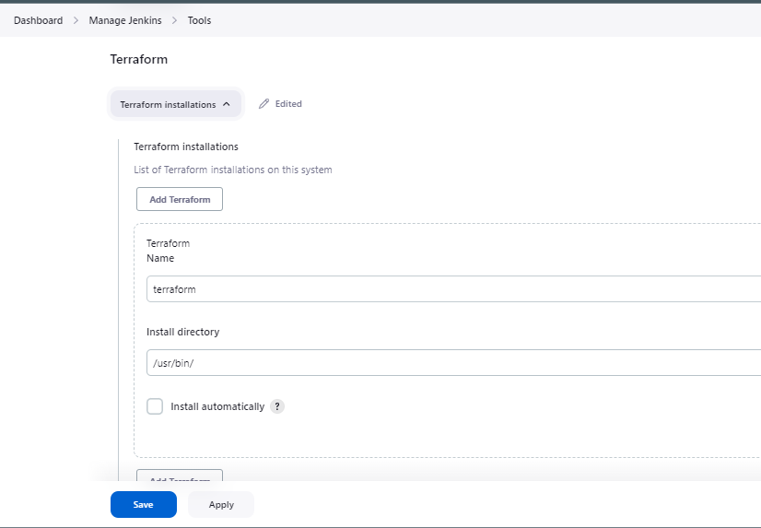
CONFIGURING TERRAFORM TO JENKINS

Slide 22
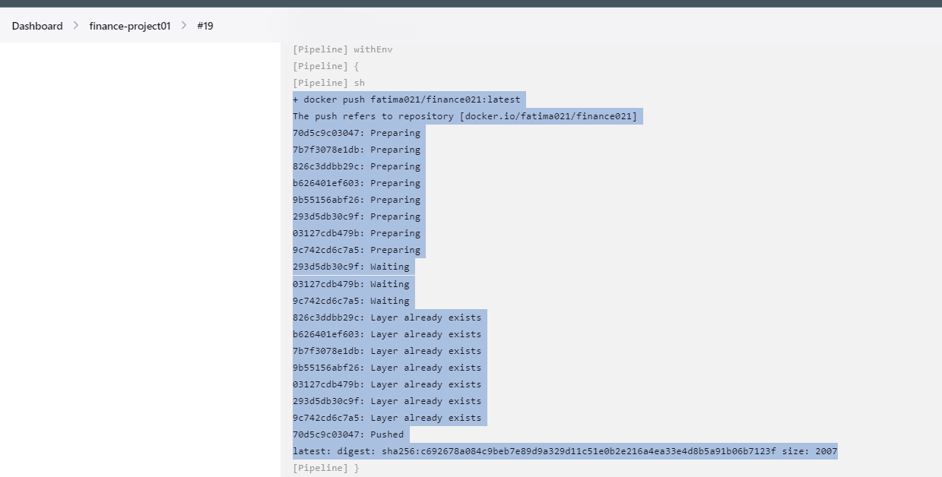
SUCCESSFULLY PUSHED THE DOCKER IMAGE TO THE DOCKERHUB REGISTRY

Slide 23
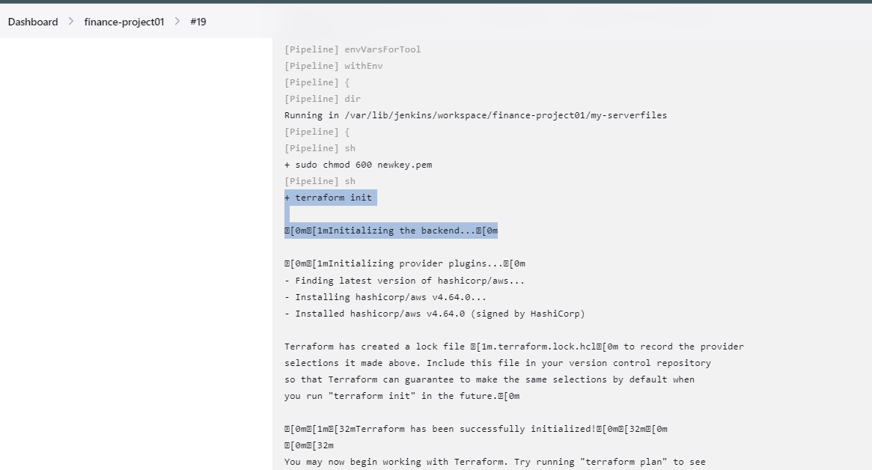
TERRAFORM IS INITIALIZED IN THE JENKINS

Slide 24
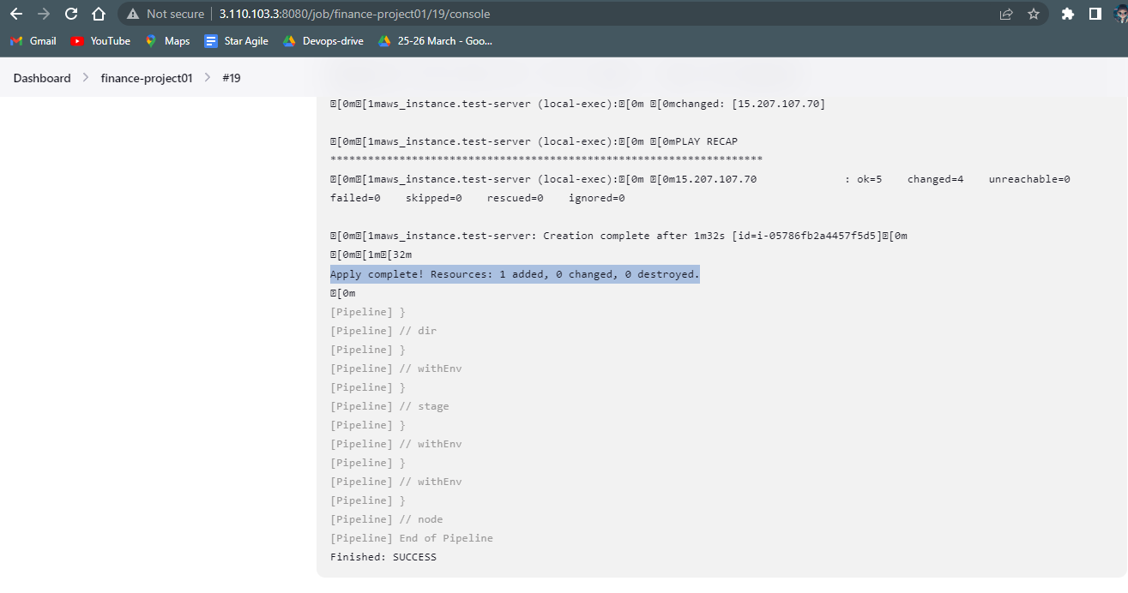
SUCCESSFULLY LAUNCHED A TEST-SERVER WITH THE HELP OF TERRAFORM

Slide 25
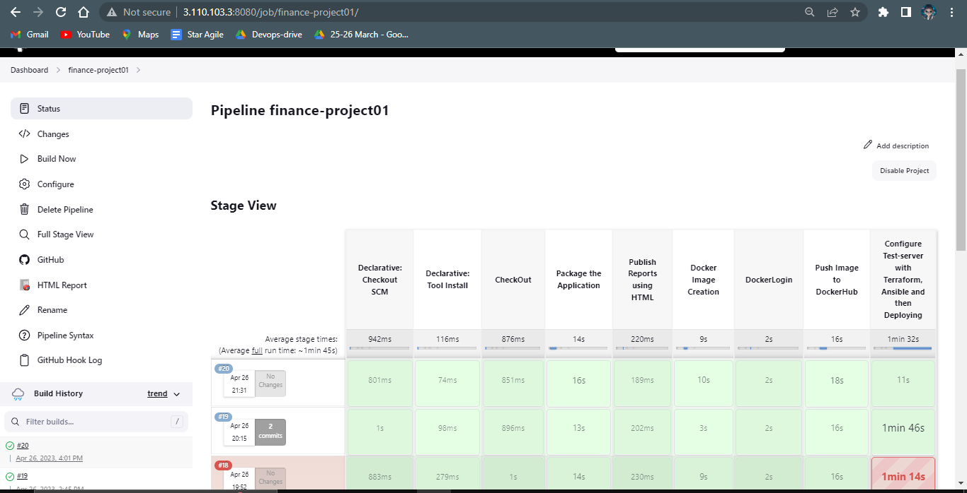
COMPLETED CONFIGURING THE TEST-SERVER AND DEPLOYING SUCCESSFULLY.

Slide 26
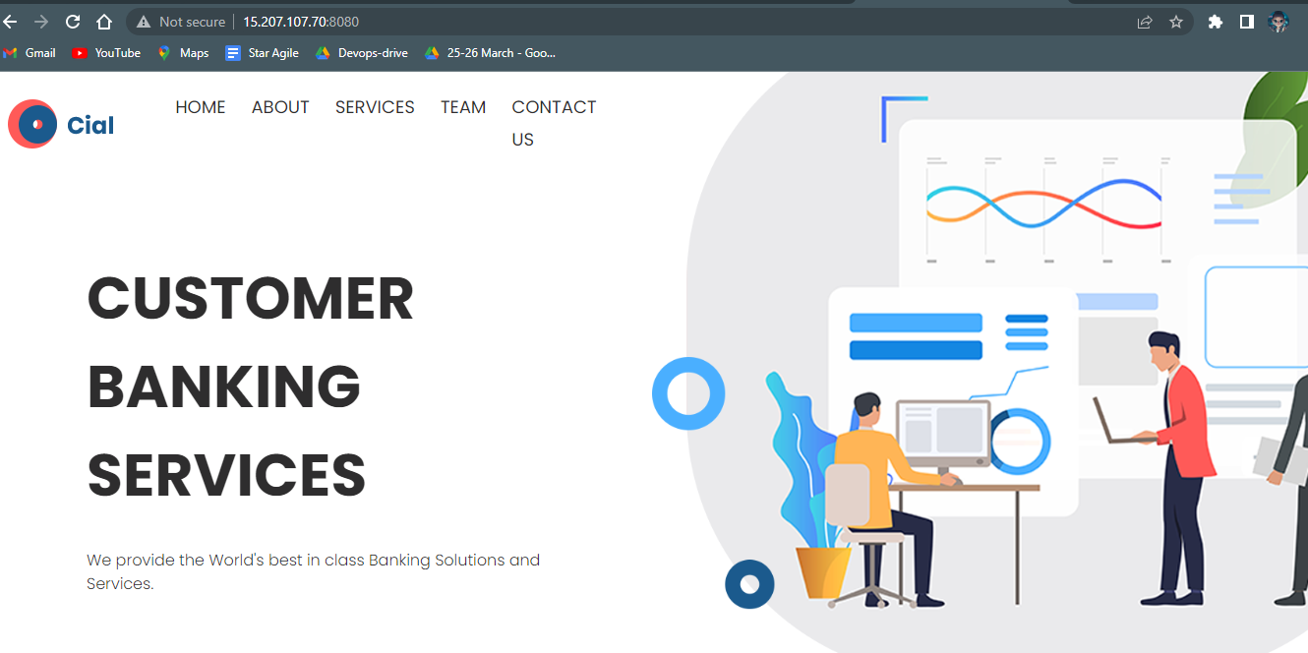
VERFYING THE APPLICATION IS RUNNING ON THE BROWSER

Slide 27
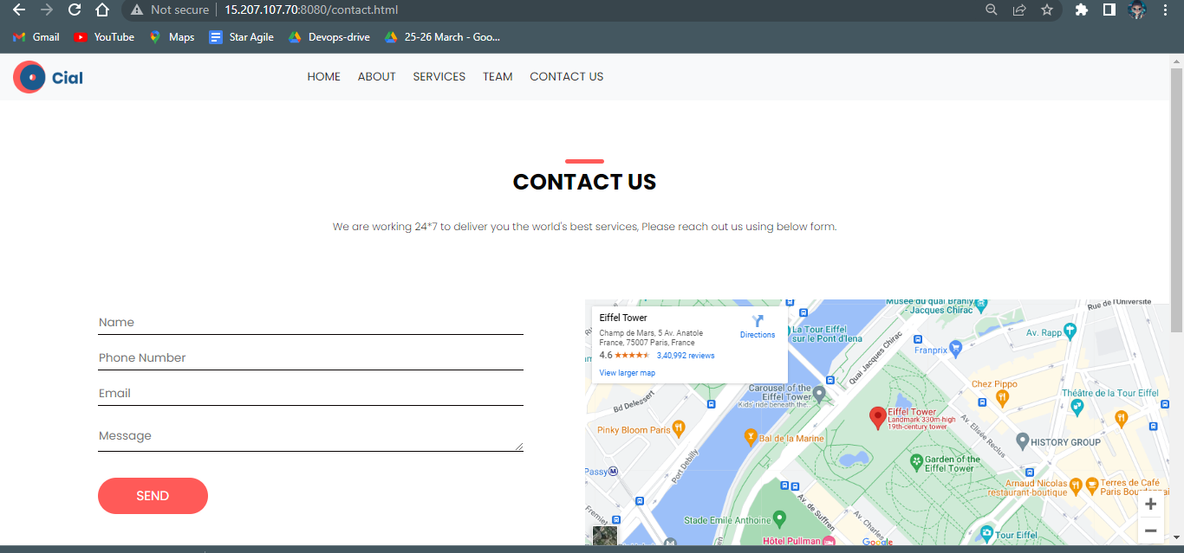
OPENED THE CONTACT-US PAGE TO EXECUTE SELENIUM TEST CASES.

Slide 28
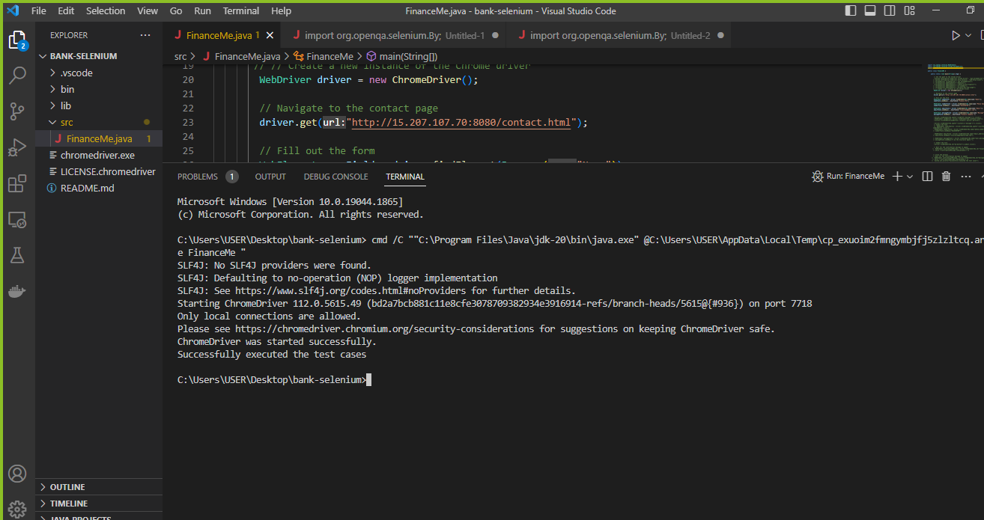
SUCCESSFULLY EXECUTED SELENIUM TEST CASES

Slide 29
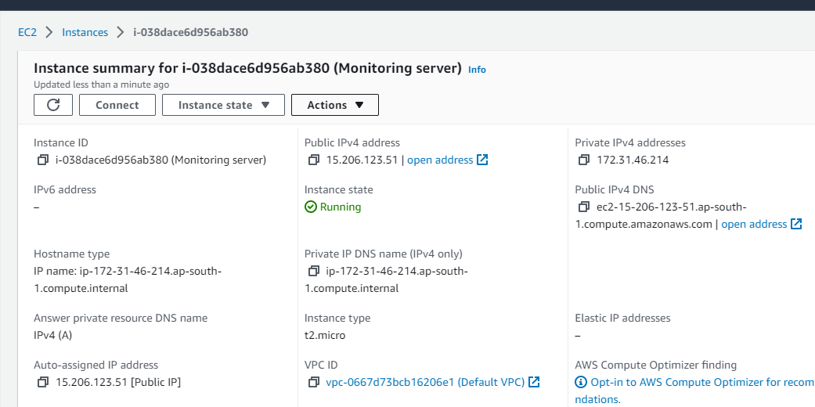
INSTALLING ANOTHER EC2 FOR MONITORING

Slide 30
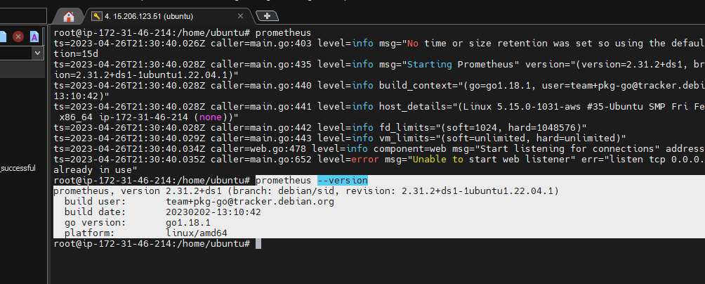
INSTALLING PROMETHEUS

Slide 31
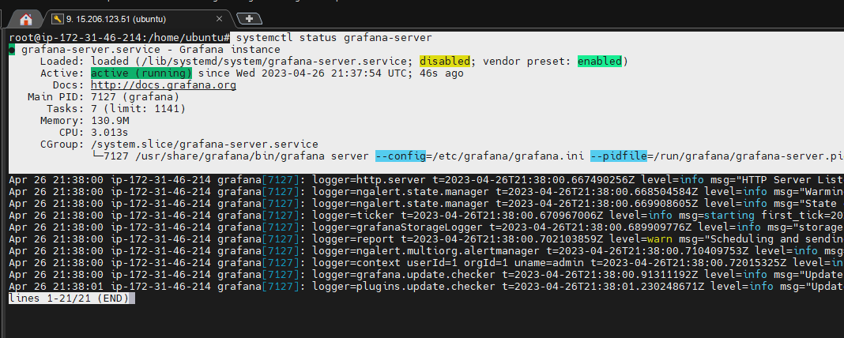
INSTALLING GRAFANA

Slide 32
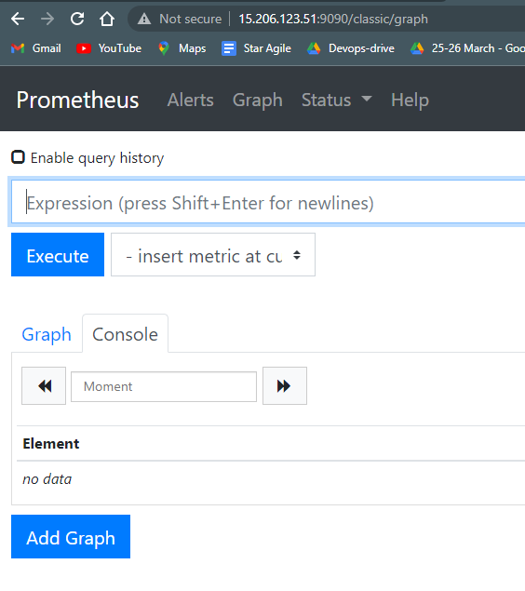
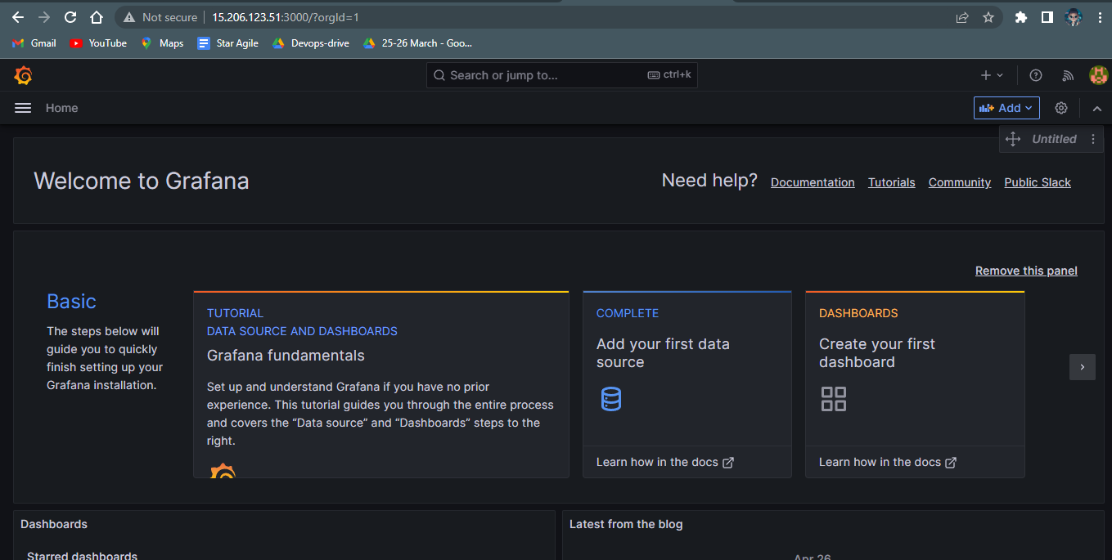
VERIFYING PROMETHEUS AND GRAFANA

Slide 33
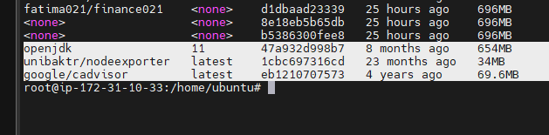
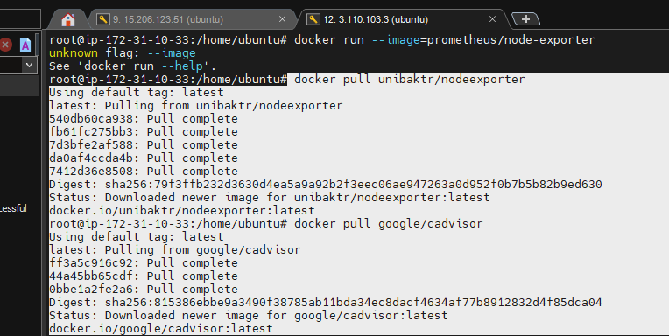
PULLING NODE-EXPORTER AND CADVISOR FROM CONTAINER REGISTRY PLATFORMS

Slide 34
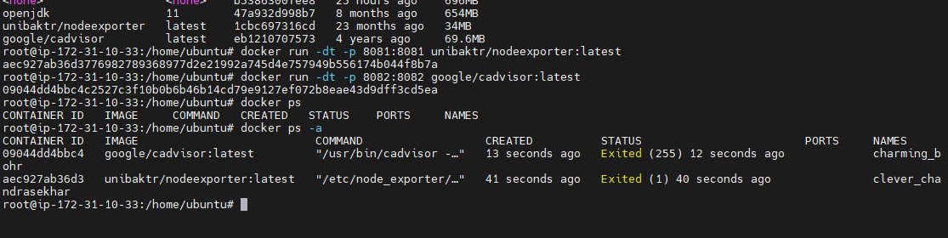
CHECKING IF THE NODES ARE UP AND RUNNING ON PROMETHEUS

Slide 35
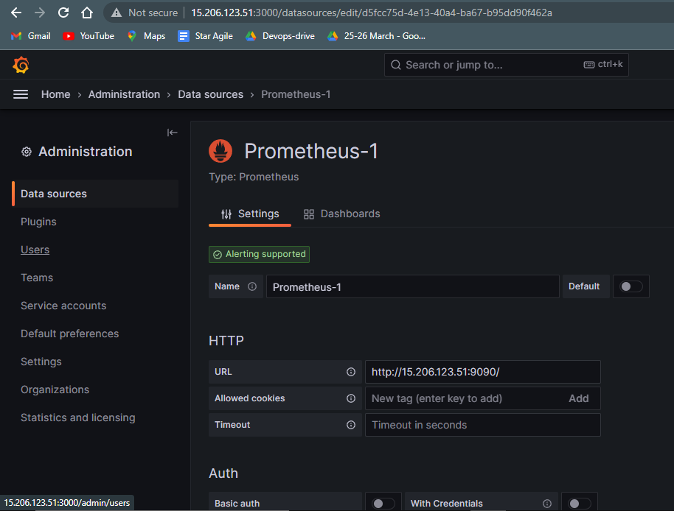
ADDING PROMETHEUS AS DATA SOURCE IN GRAFANA

Slide 36
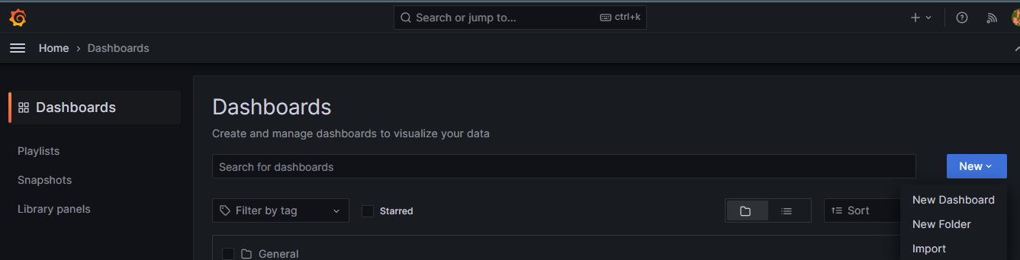
CREATING A NEW DASH BORAD

Slide 37
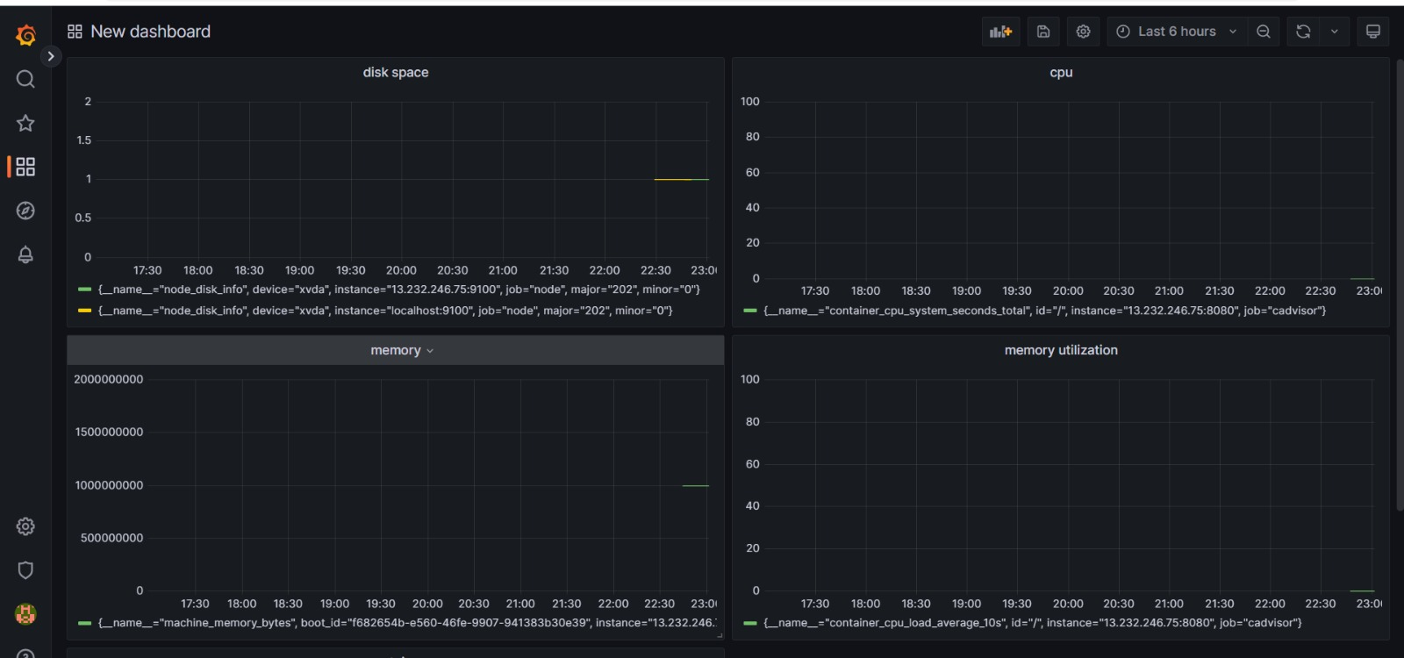
VISUALIZED THE MONITORING PANELS RESPECTIVELY

Slide 38
DONE BY :
ISHRATH FATIMA

